Slide 1
Capstone of Mohamed Mohamar
Statistics & Modeling
Coding with Performance on Big Data
Communicating Results for Decision-Making
Venn Diagram of Data Science Skills

Slide 2
Contribution of Competitor’s Article
Title: Single-hidden layer neural networks for forecasting intermittent demand
In this article, the authors are proposing a method that uses a single-hidden layer feedforward neural network for forecasting intermittent demand
Their proposal aims to “helping the network to learn the temporal behavior of the time series in terms of zero/non-zero demand” (Lollia et al. 2017).

Slide 3
Novel Contribution
This work is an effort to contribute to the research and the exploration of Neural Networks.
The contribution is to help understand Neural Networks better and show how they can be successfully applied to stock market data analysis.

Slide 4
Novel Contribution
The proposal is inspired by the previous excellent work that has been done by data scientists and other professionals using Neural Networks.
My idea is to perform a comparative analysis of linear regression and neural network time series analysis to build a model to predict and forecast stock market volatility.

Slide 5
Data Source and Content
The original full data set that I am using was provided by Professor Robert Finn last semester during our DS-640 course. It is a stock market data set. It contains data about Income Statement, Cash Flow Statement, Balance Sheet, and Metrics and Ratios.
I am only using a subset of the data corresponding to the ARQ (As Reported Quarterly) listings, meaning where Dimension = ARQ. The Rows are the quarterly calendar date Time Series. The Columns are twenty chosen indicators along with the calculated Returns and Log of returns.

Slide 6
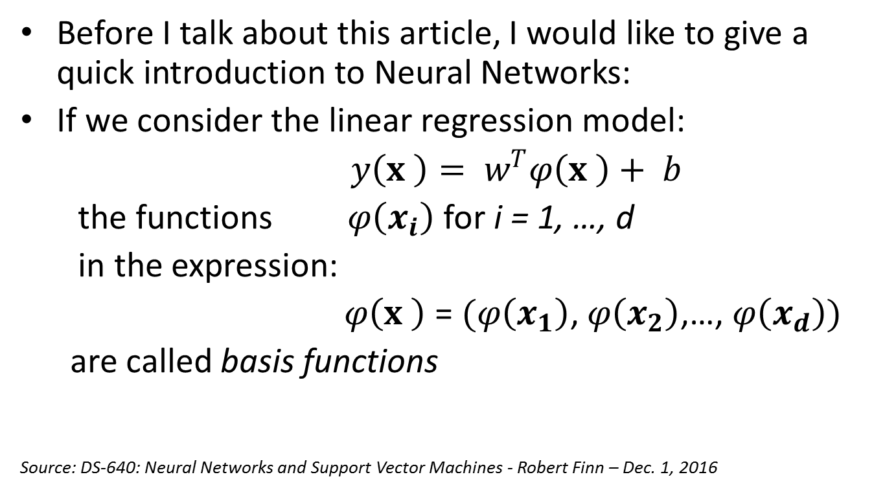
Introduction to Neural Networks
Before I talk about this article, I would like to give a quick introduction to Neural Networks:
If we consider the linear regression model:
$y\left(x \right)= w^{T}φ\left(x \right)+ b$
the functions $φ\left(x_{i}\right)$ for i = 1, …, d
in the expression:
$φ\left(x \right)$ = $(φ\left(x_{1}\right)$, $φ\left(x_{2}\right)$,…, $φ\left(x_{d}\right))$
are called basis functions
Source: DS-640: Neural Networks and Support Vector Machines - Robert Finn – Dec. 1, 2016

Slide 7
Introduction to Neural Networks
Instead of linear regression, let’s allow the functions of the independent variables, or basis functions, to be adaptive.
Meaning that we use parametric forms for the basis functions in which the parameter values are adapted during training.
A very successful model of this type is the feed-forward neural network, also known as the multilayer perceptron, which is based on the perceptron algorithm.
Source: DS-640: Neural Networks and Support Vector Machines - Robert Finn – Dec. 1, 2016

Slide 8
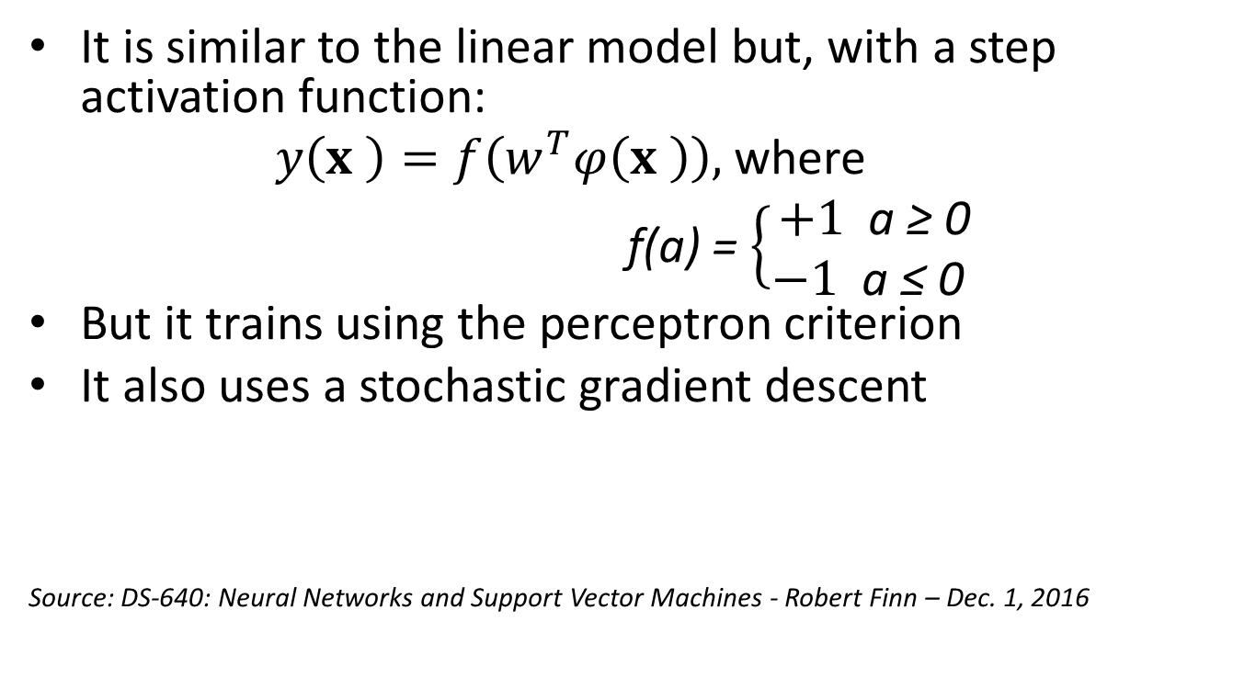
Introduction to Neural Networks
It is similar to the linear model but, with a step activation function:
$y\left(x \right)=f\left(w^{T}φ\left(x \right)\right),$where
f(a) = $\left\{\begin{aligned}+1 \text{a}\text{ ≥ 0} \\ −1 \text{a}\text{ ≤ 0 }\end{aligned}\right.$
But it trains using the perceptron criterion
It also uses a stochastic gradient descent
Source: DS-640: Neural Networks and Support Vector Machines - Robert Finn – Dec. 1, 2016

Slide 9
Introduction to Neural Networks
Perceptron convergence theorem: If there exists an exact solution, i.e. if the training set is indeed linearly separable, then the Perceptron Algorithm will find a solution in finite number of steps.
Source: DS-640: Neural Networks and Support Vector Machines - Robert Finn – Dec. 1, 2016

Slide 10
Introduction to Neural Networks
For many applications, neural networks can be significantly more compact and faster to evaluate than a support vector machine.
But at a certain price: the likelihood function, which forms the basis for network training, is no longer a convex function of the model parameters.
In practice, however, it is often worth investing substantial computational resources during the training phase in order to obtain a compact model that is fast at processing new data
Source: DS-640: Neural Networks and Support Vector Machines - Robert Finn – Dec. 1, 2016

Slide 11
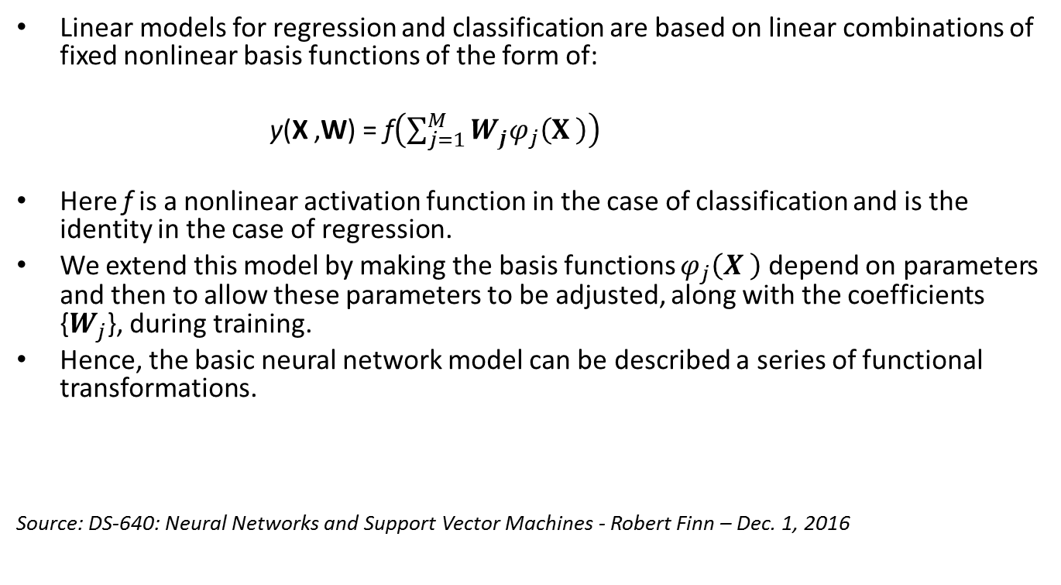
Introduction to Neural Networks
Linear models for regression and classification are based on linear combinations of fixed nonlinear basis functions of the form of:
y(X ,W) = f$\left(\sum_{j=1}^{M}{W_{j}φ_{j}\left(X \right)}\right)$
Here f is a nonlinear activation function in the case of classification and is the identity in the case of regression.
We extend this model by making the basis functions $φ_{j}\left(X \right)$ depend on parameters and then to allow these parameters to be adjusted, along with the coefficients {$W_{j}$}, during training.
Hence, the basic neural network model can be described a series of functional transformations.
Source: DS-640: Neural Networks and Support Vector Machines - Robert Finn – Dec. 1, 2016

Slide 12
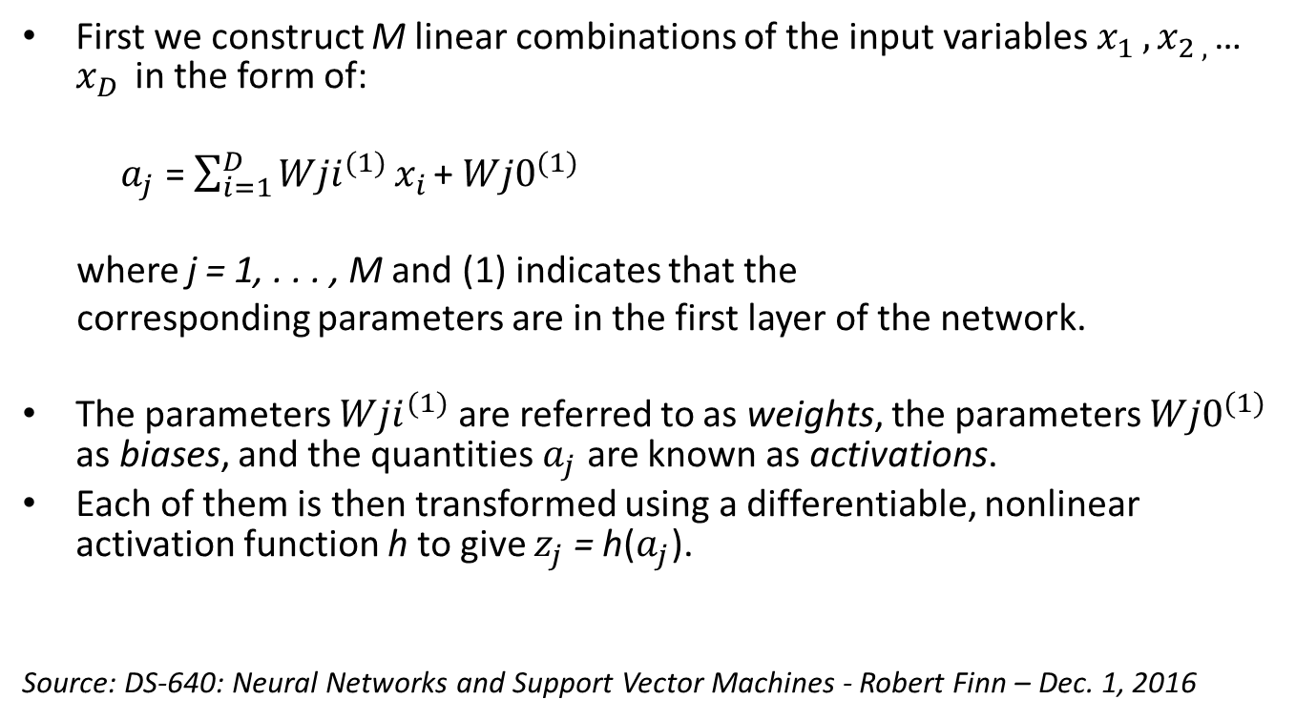
Introduction to Neural Networks
First we construct M linear combinations of the input variables $x_{1 },x_{2 , }$… $x_{D }$in the form of:
$a_{j}$ = $\sum_{i=1}^{D}{{Wji}_{}^{(1)}}x_{i }$+ ${Wj0}_{}^{(1)}$
where j = 1, . . . , M and (1) indicates that the
corresponding parameters are in the first layer of the network.
The parameters ${Wji}_{}^{(1)}$ are referred to as weights, the parameters ${Wj0}_{}^{(1)}$ as biases, and the quantities $a_{j}$ are known as activations.
Each of them is then transformed using a differentiable, nonlinear activation function h to give $z_{j}$ = h($a_{j}$).
Source: DS-640: Neural Networks and Support Vector Machines - Robert Finn – Dec. 1, 2016

Slide 13
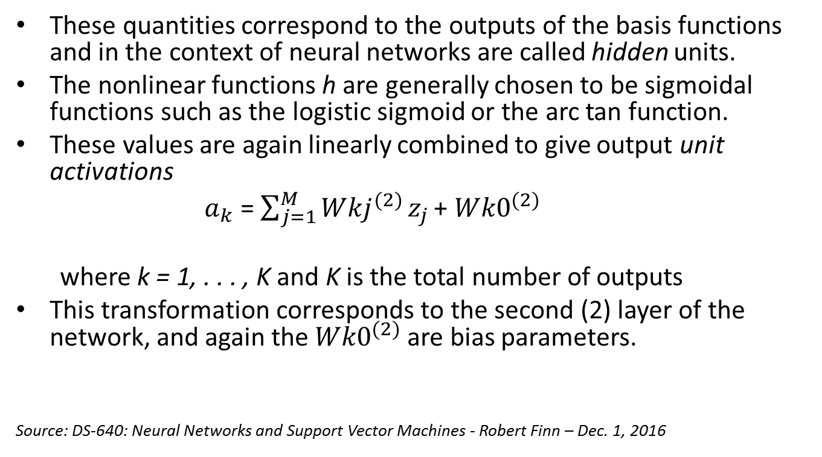
Introduction to Neural Networks
These quantities correspond to the outputs of the basis functions and in the context of neural networks are called hidden units.
The nonlinear functions h are generally chosen to be sigmoidal functions such as the logistic sigmoid or the arc tan function.
These values are again linearly combined to give output unit activations
$a_{k}$ = $\sum_{j=1}^{M}{{Wkj}_{}^{(2)}}z_{j }$+ ${Wk0}_{}^{(2)}$
where k = 1, . . . , K and K is the total number of outputs
This transformation corresponds to the second (2) layer of the network, and again the ${Wk0}_{}^{(2)}$are bias parameters.
Source: DS-640: Neural Networks and Support Vector Machines - Robert Finn – Dec. 1, 2016

Slide 14
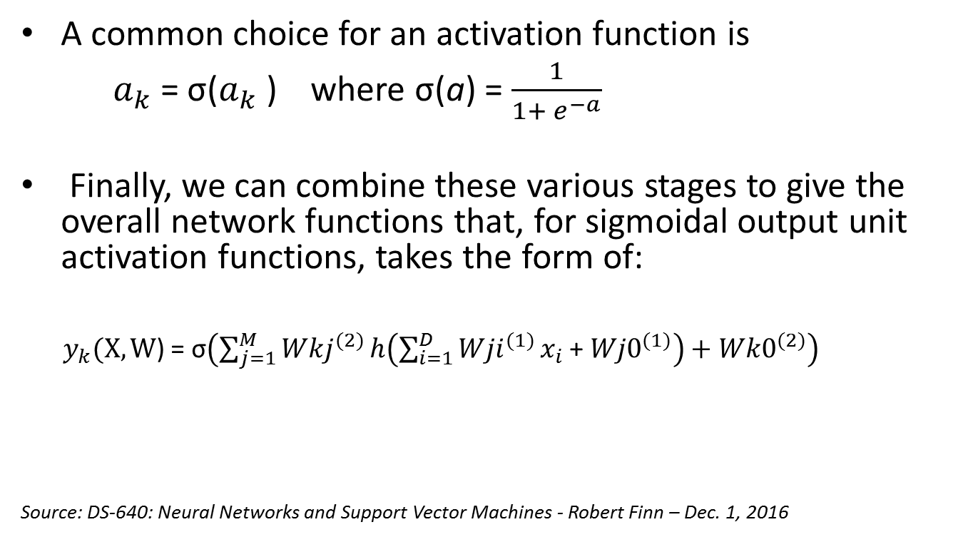
Introduction to Neural Networks
A common choice for an activation function is
$a_{k}$ = σ($a_{k}$ ) where σ(a) = $\frac{1}{1+ e^{−a}}$
Finally, we can combine these various stages to give the overall network functions that, for sigmoidal output unit activation functions, takes the form of:
$y_{k}(X,W$) = σ$\left(\sum_{j=1}^{M}{{Wkj}_{}^{(2)}}h\left(\sum_{i=1}^{D}{{Wji}_{}^{(1)}}x_{i }\text{+ }{Wj0}_{}^{(1)}\right)+{Wk0}_{}^{(2)}\right)$
Source: DS-640: Neural Networks and Support Vector Machines - Robert Finn – Dec. 1, 2016

Slide 15
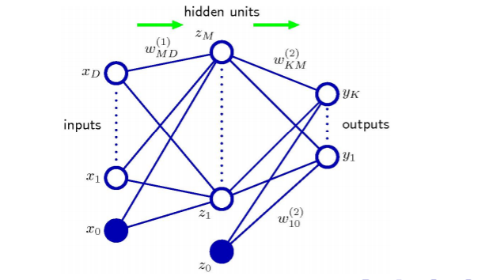
Algorithm Overview
Source : DS-640: Neural Networks and Support Vector Machines - Robert Finn – Dec. 1, 2016

Slide 16
Your Method
For implementation, R programming packages LM and NEURAL NETWORK are used.
The NEURAL NETWORK package is based on the back-propagation gradient descent algorithm.
I am utilizing a double-hidden layer neural network for training.

Slide 17
Your Method
I first used an R for loop to compute the returns from price using the formula:
Returns = P(i)/P(i-1). I added it to the data set as separate column.
After selecting the twenty indicators along with two columns: ticker and calendar date, I then used another R for loop to compute the log of returns and added it to the data set as a separate column.

Slide 18
Your Method
Because there are some zeros in the Returns column, using the log of returns rendered some R infinite (Inf) values in the Log of returns column.
I converted those infinite values into “NAs”, before cleaning the data set from all the “NAs”.

Slide 19
Your Method
Normalized factor = (factor – mean (factor))/sd (factor)
Generate time series for the 20 betas derived from my linear regression of log-returns on your 20 chosen factors over the first three quarters of the dates for which I have data
Forecast the 20 betas for the first date not included in the model
This expected return will then be used to rank my stocks and split them into 5 groups with group 1 having the highest expected return and group 5 the lowest.
Perform the same task using a neural network instead of a linear model

Slide 20
Quantitative Results 1
Groups | Average returns for 2011-12-31 | Predicted returns for 2011-12-31
Group 1 | 0.11920804902 | 0.10329895143
Group 2 | 0.11864927415 | 0.08354768423
Group 3 | 0.10646070662 | 0.07487498111
Group 4 | 0.05638041033 | 0.05834756905
Group 5 | -0.02173637167 | -0.00277221546
Table 1.1: Compared returns for 2011-12-31

Slide 21
Quantitative Results 2
Groups | Average returns for 2012-12-31 | Predicted returns for 2012-12-31
Group 1 | 0.114665701169 | 0.11928866714
Group 2 | 0.115336406124 | 0.10229519698
Group 3 | 0.127731203722 | 0.09334380542
Group 4 | 0.093139804160 | 0.08427562973
Group 5 | -0.008158161041 | 0.03373893868
Table 1.2: Compared returns for 2012-12-31

Slide 22
Quantitative Results 3
Groups | Average returns for 2013-12-31 | Predicted returns for 2013-12-31
Group 1 | 0.12644519447 | 0.15312263061
Group 2 | 0.06797968658 | 0.09074951366
Group 3 | 0.05911131016 | 0.08574644381
Group 4 | 0.05774970242 | 0.07914463761
Group 5 | 0.04230322318 | 0.03131959371
Table 1.3: Compared returns for 2013-12-31

Slide 23
Discussion: Comparison With Your Competitor
Competitor’s Results
Your Results
The authors argue that “this comparison was then enriched by adopting two different accuracy metrics on different time horizons. Such a detailed comparison aims at bridging the gap between theory and practice of ANNs in the field of intermittent demand. In fact, the potential for implementation of ANNs in real environments can only increase by providing useful guidelines about their design and training for practitioners. (Lollia et al. 2017).
For the 4th quarter of 2011, predictions are lower for group 1 with an average return of 0.12 and a predicted return of 0.10. For group 2, predictions are lower as well, with an average return of 0.12 and a predicted return of 0.08. Predictions are lower for group 3 with an average return of 0.11 and a predicted return of 0.07. Predictions are higher and close for group 4 with an average return of 0.056 and a predicted return of 0.058. We see a similar trend for group 5, lower and close, with an average return of -0.022 and a predicted return of -0.003. Predictions for group 5 remain in negative territory for this quarter.

Slide 24
Discussions
For the fourth quarter of 2012, a comparison between the average log of returns and the predicted returns using neural network shows that overall they are pretty close for all the groups.
Predictions are higher for group 1 with an average return of 0.11 and a predicted return of 0.12.
For group 2, predictions are little lower, with an average return of 0.12 and a predicted return of 0.10.
We see the same trend for group 3 with an average return of 0.13 and a predicted return of 0.09.
Predictions are lower but very close for group 4 with an average return of 0.09 and a predicted return of 0.08.
Predictions are higher for group 5, with an average return of -0.008 and a predicted return of 0.034.

Slide 25
Performance on Big Data: Time Measurements
For loop to estimate returns based on price: 47.83 sec elapsed
nn.model_2011_03_31 <- neuralnet(nn.formula, data=n.market_data.factors_2011_03_31, hidden=c(7,7), linear.output = T): 201.605 sec elapsed

Slide 26
Conclusion
Overall, the double-hidden layer Neural Network model has performed better than Linear Regression model.
Predicted returns are closer to the actual average returns using NEURALNET.
The only limitation is that it takes time to train the neural network.

Slide 27
Conclusion
If we increase the threshold during the training of the neural network, it will converge faster but the precision of the predictions will be affected.
Many more trainings of the neural network should be conducted in order for the model to improve.

Slide 28
Questions?
What statistical method was used?
What programming tool was used?
What scientific contribution was made?
What idea could be useful for your project?

